Slide 1
LLNet: A Deep Autoencoder approach to Natural Low-light Image Enhancement

Slide 2
Kin Gwn Lore(First author) : Iowa State University, Ames（爱荷华州立大学） Graduate Research Assistant Skills and expertise：Neurl Networks、Machine Learning、Feature Extraction、Artificial Inteligence

Slide 3
LLNet
Preparation knowledge
Overview
Introduction and motivation
Low-light Net (LLNet)
Evaluation metrics
Results-and-discussion

Slide 4
Preparation knowledge
Autoencoder Networks
Histogram equalization (HE)
AHE
CLAHE
Gamma adjustment(GA)
(HE+BM3D)

Slide 5
LLNet
Preparation knowledge
Overview
Introduction and motivation
Low-light Net (LLNet)
Evaluation metrics
Results-and-discussion

Slide 6
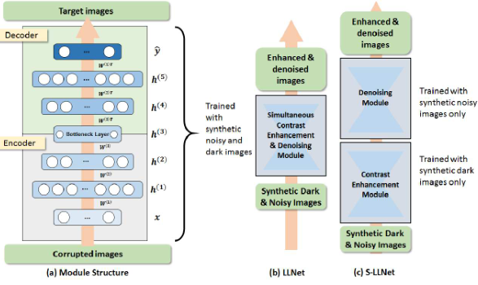
LLNet- and- S-LLNet
Overview

Slide 7
LLNet
Preparation knowledge
Overview
Introduction and motivation
Low-light Net (LLNet)
Evaluation metrics
Results-and-discussion

Slide 8
Introduction and motivation
1. Good quality images and videos are key to critical auto-mated and human-level decision-making for many tasks
2. Deep learning-based approaches gained immense traction as they are shown to outperform other state-of-the-art machine learning tools in many computer vision applications
3. Propose LLNet and S-LLNet

Slide 9
LLNet
Preparation knowledge
Overview
Introduction and motivation
Low-light Net (LLNet)
Evaluation metrics
Results-and-discussion

Slide 10
Low-light Net (LLNet)
Learning features from low-light images
Network parameters
Training the model
Image reconstruction

Slide 11
Learning features from low-light images

Slide 12
With DA, feed-forward learning functions are defined to characterize each element of M by the expression h(x) = σ(Wx + b) and
ˆ y(x) = σ ′ (W ′ h + b ′ ), where σ and σ ′ denote the encoding and decoding functions (either of which is usually the sigmoidfunctionσ(s) or σ ′ (s) = (1+exp(−s)) −1 of asingle DA layer with K units, respectively.

Slide 13
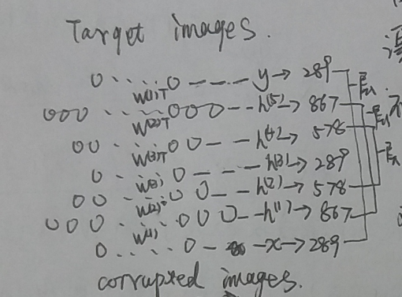
Network parameters

Slide 14
The network is pre-trained for 30 epochs with pre-training learning rates of 0.1 for the first two DA layers and 0.01 for the last DA layer, whereas finetuning was performed with a learning rate of 0.1 for the first 200 finetuning epochs, 0.01 afterwards, and stops only if the improvement in validation error is less than 0.5%.

Slide 15
Training the model
预训练阶段
I train =n(g(I original )) where function g(·) represents the gamma adjustment function and n(·) represents the noise function.
Where N is the number of patches, θ = {W,b,W ′ ,b ′ } are the parameters of the model, KL(ˆ ρ j ||ρ) is the Kullback- Leibler divergence(作用是诱导稀疏)

Slide 16

Training the model
训练阶段
I train =n(g(I original )) where function g(·) represents the gamma adjustment function and n(·) represents the noise function.
缺少了诱导稀疏项

Slide 17
Image reconstruction
The test image is first broken up into overlapping 17 × 17 patches with stride size of 3 × 3.
We find that using a patching stride of 2 × 2 or
even1×1(fully overlapped patches) do not produce significantly superior results.

Slide 18
LLNet
Preparation knowledge
Overview
Introduction and motivation
Low-light Net (LLNet)
Evaluation metrics
Results-and-discussion

Slide 19
Evaluation metrics Compared methods
Image reconstruction
Peak signal-to-noise ratio (PSNR)
Structural similarity index (SSIM)
Compared methods
HE、CLAHE、GA 、HE+BM3D

Slide 20
LLNet
Preparation knowledge
Overview
Introduction and motivation
Low-light Net (LLNet)
Evaluation metrics
Results-and-discussion

Slide 21
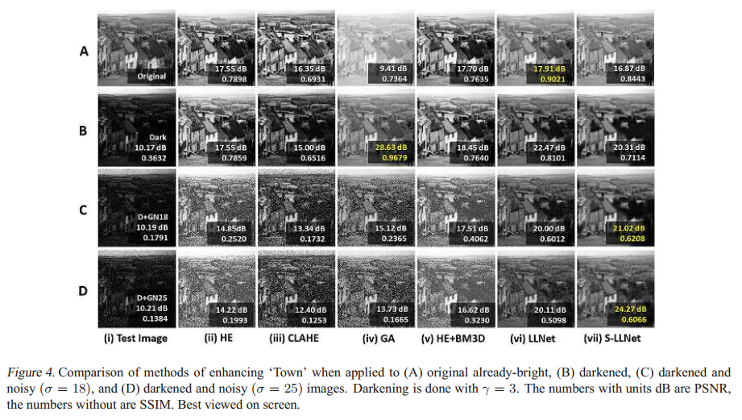
Result and discussion

Slide 22
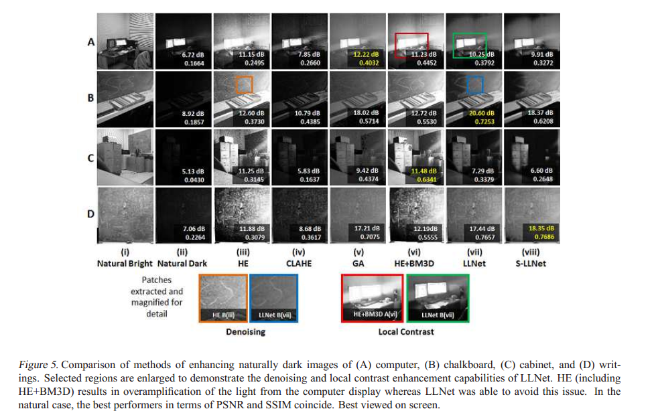

Slide 23
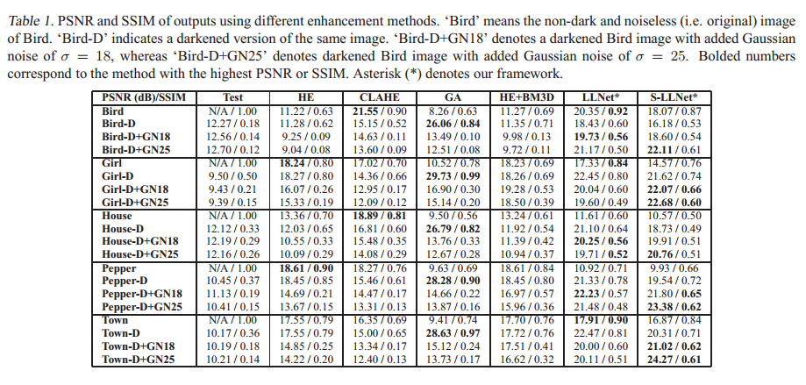

Slide 24
